Slide 1
Great Theorem: Newton’s Approximation of Pi
Newton
Journey Through Genius Pp 174

Slide 2
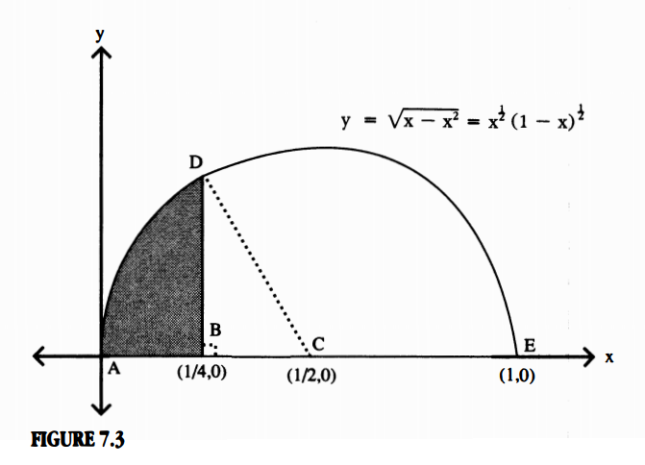
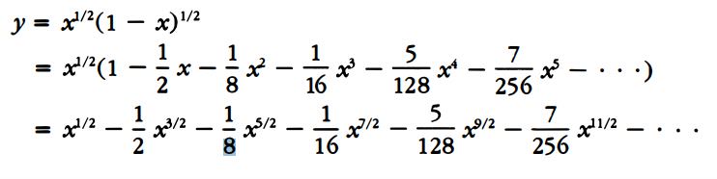
Preliminaries
Newton starts with a semi circle centered at (½ , 0)
Given this circle’s equation, Newton solves for y
He then uses the Binomial expansion on y
Newton constructed BD, perpendicular to the semi-circle’s diameter, such that B is located at the midpoint of radius AC

Slide 3
Newton’s Approach:
Part 1: Area ABD by fluxions
Part 2: Area ABD by geometry

Slide 4
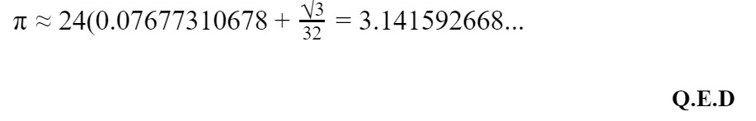
Final Result:
*by equating the two results from the methods for calculating the area, and solving for 𝜋, we get
This is accurate to seven digits, this clearly demonstrated the efficacy of Newton’s new methods, and this was using only nine terms of the binomial expansion.

